Slide 1

Department of Computer Science and Engineering
Stamford University Bangladesh
Online Courier Service Management
Tanveer Ahmed
Senior Lecturer, Dept. of CSE
Md Nazim Uddin CSE 063 07429
Priyanka Rani Satu CSE 063 07380
Md Naeemul Hasan CSE 063 07438

Slide 2
Introduction
1.Daily Activities
2.Transport system
3.Door-to-door delivery
4.GUI(graphical user interface)
5.Time saving

Slide 3
Problem Definition
1.Fully automated
2.Tracking system
3.Secure data
4.Data redundancy
5.Delivery performance

Slide 4
Objective
1.Satisfactory level of the customer
2.Facilities user to communicate
3.Software solution
4.information Technology solution

Slide 5
Project Proposal
1.It provides better and efficient service to customer
2.Reduce the workload of employee
3.Provide facility for proper monitoring
4.All service information will be available to a member

Slide 6
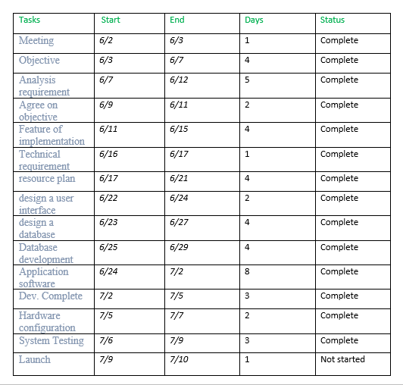
Activity planner Table

Slide 7
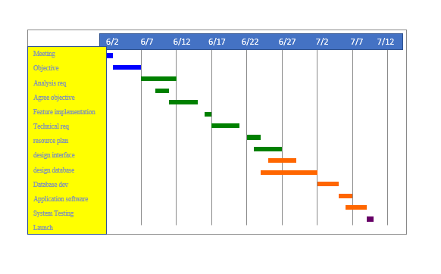
Activity planner Chart

Slide 8
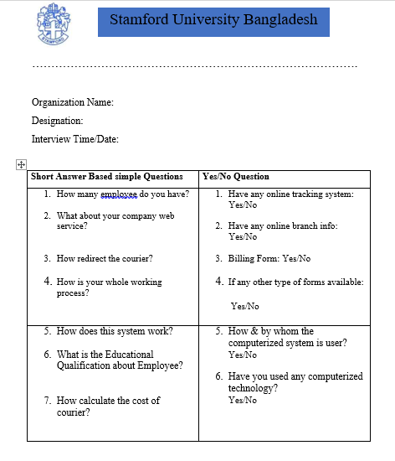
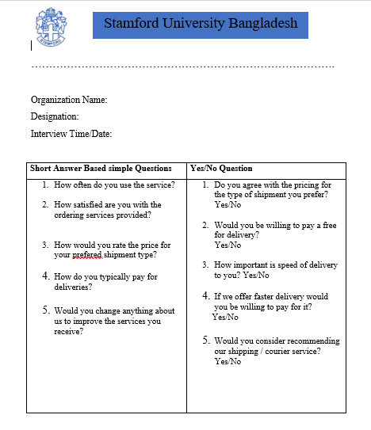
Interviews And Questioners

Slide 9
Information Gathering and Summaries
The main problem based on time.
People don’t get their delivery on time.
Software smoothness.
Two factor calling system.

Slide 10
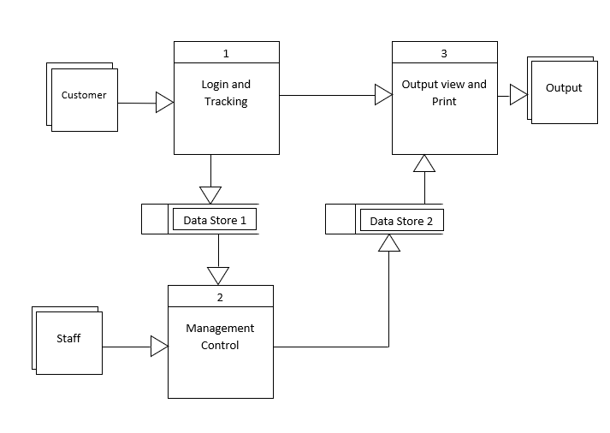
DFD : Level 0

Slide 11
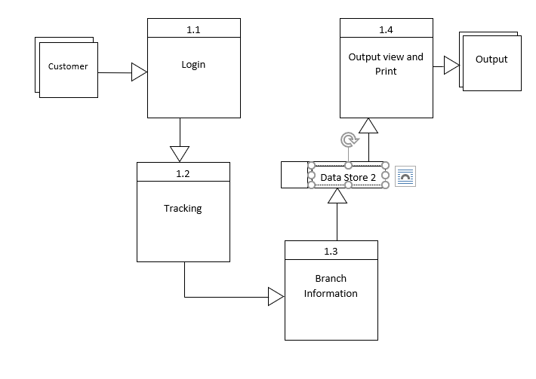
DFD : Child level

Slide 12
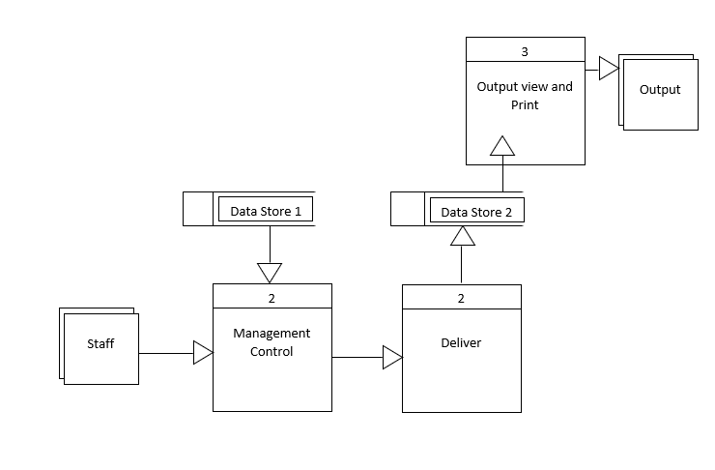
DFD : Child level

Slide 13
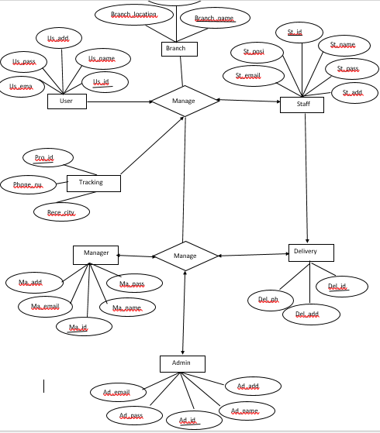
ER Diagram

Slide 14
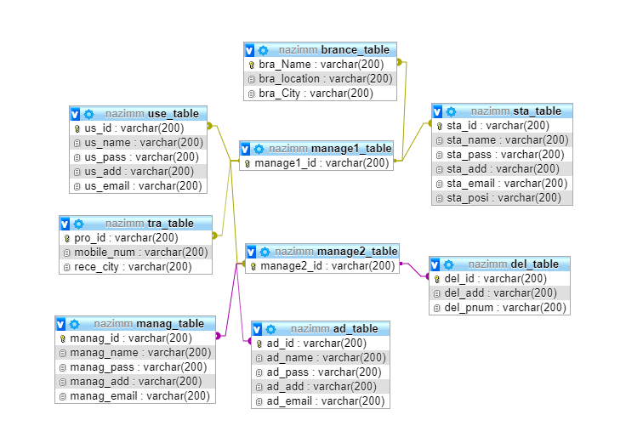
ER Diagram design

Slide 15
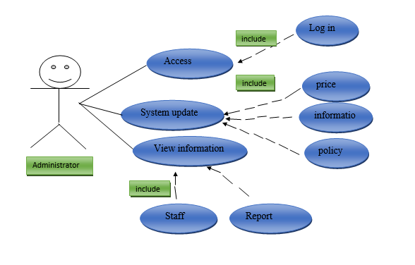
Use Case Diagram

Slide 16
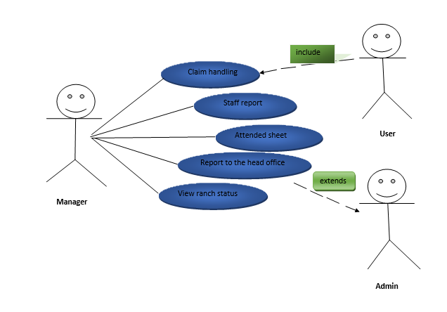
Use Case Diagram

Slide 17
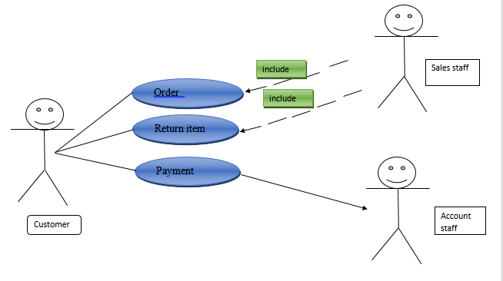
Use Case Diagram

Slide 18
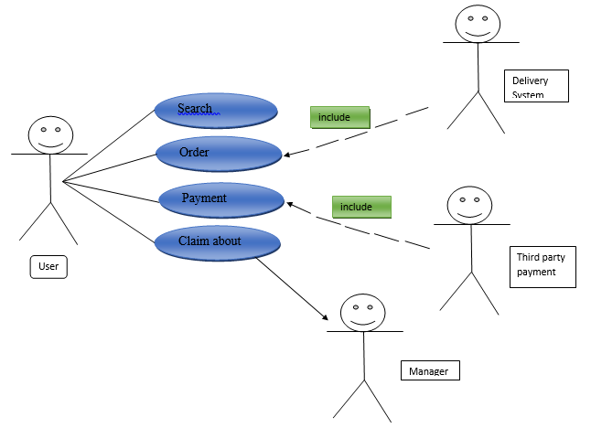
Use Case Diagram

Slide 19
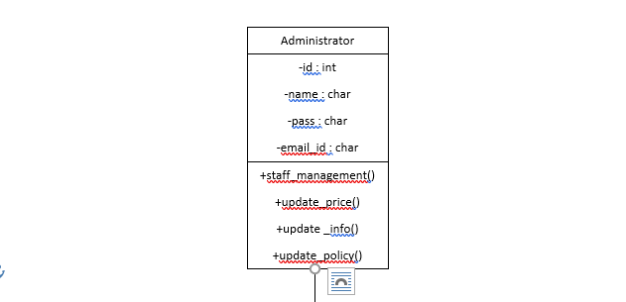
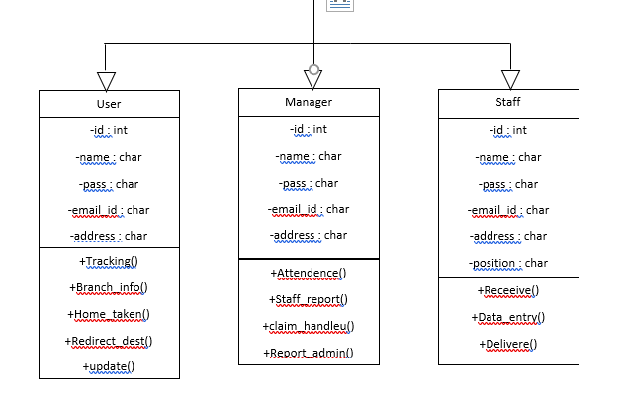
Class Diagram : Administrator

Slide 20
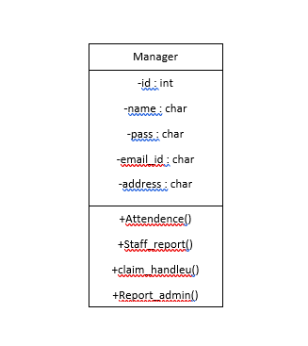
Class Diagram : Manager

Slide 21
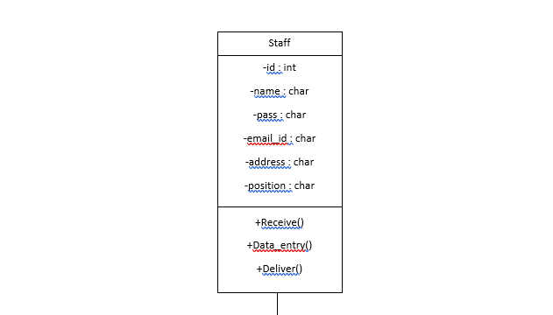
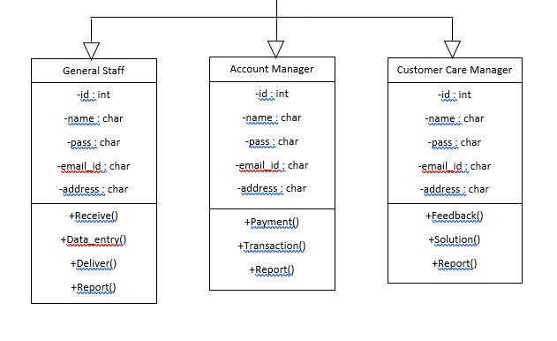
Class Diagram : Staff

Slide 22
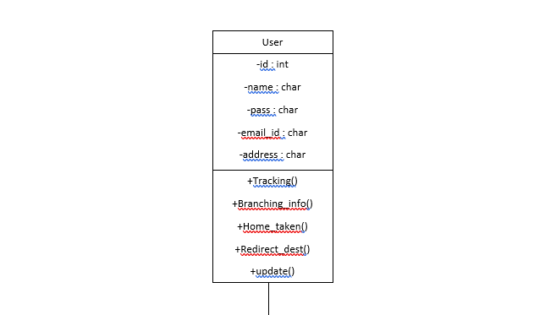
Class Diagram : User

Slide 23
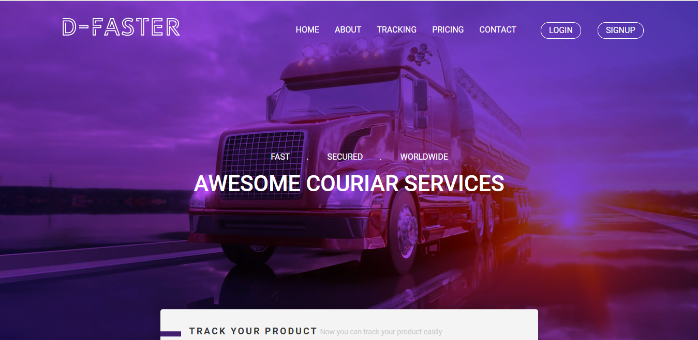
Interface : D-FASTER

Slide 24
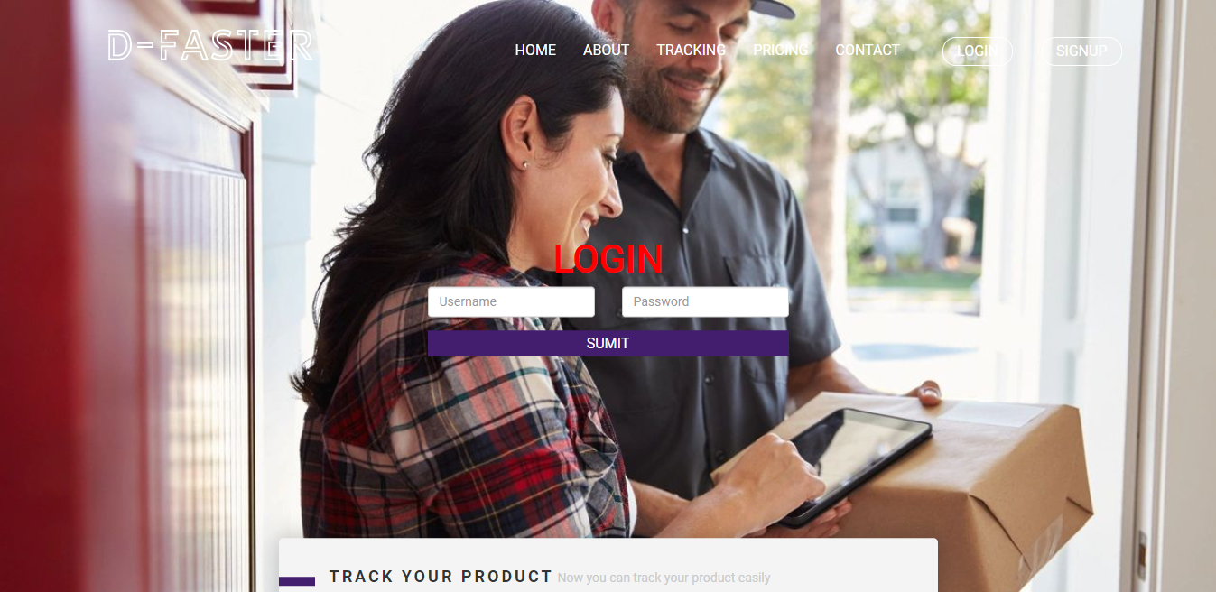
Interface : D-FASTER

Slide 25
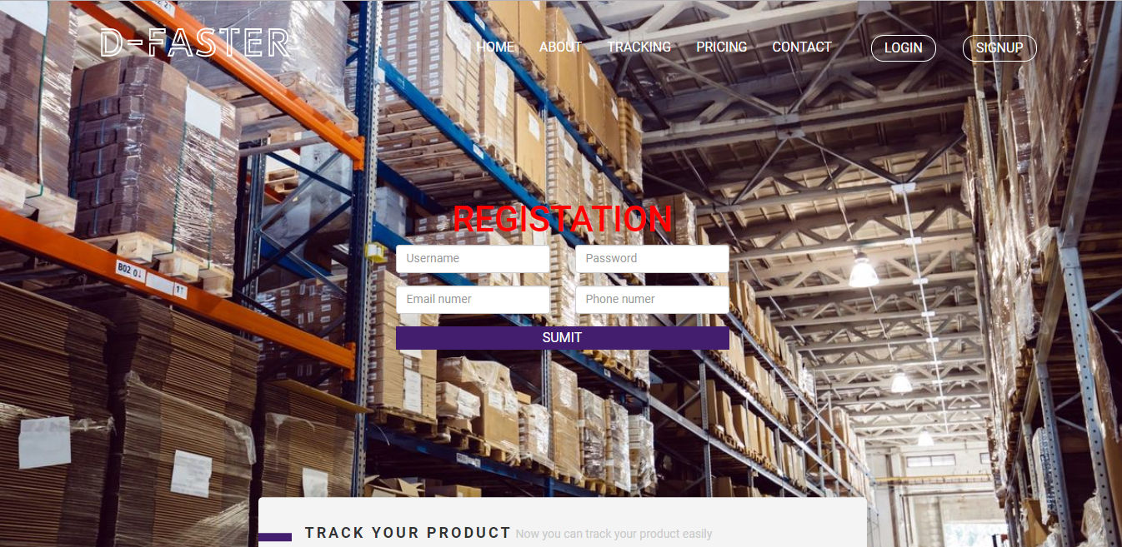
Interface : D-FASTER

Slide 26
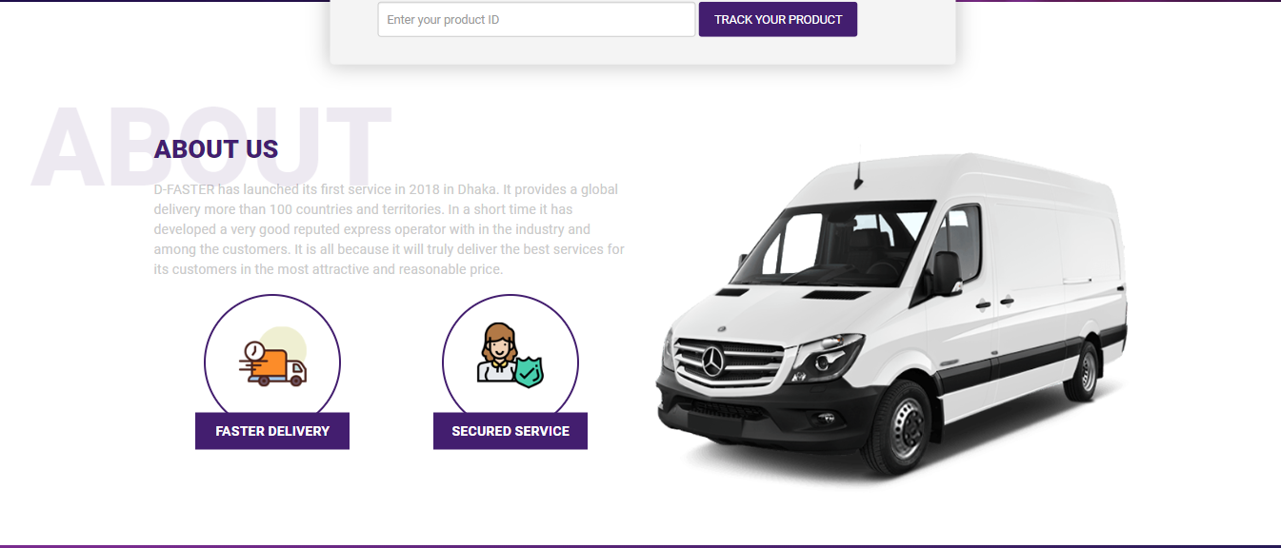
Interface : D-FASTER

Slide 27

Interface : D-FASTER

Slide 28
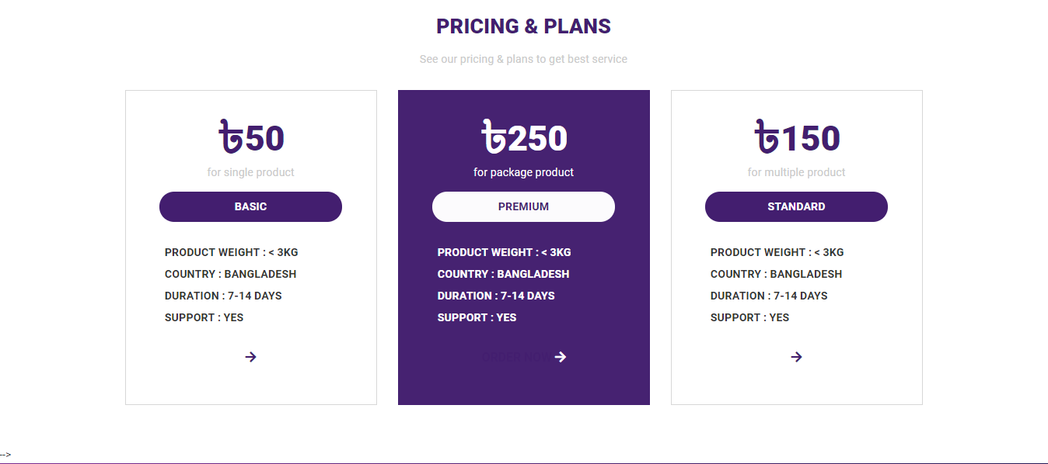
Interface : D-FASTER

Slide 29
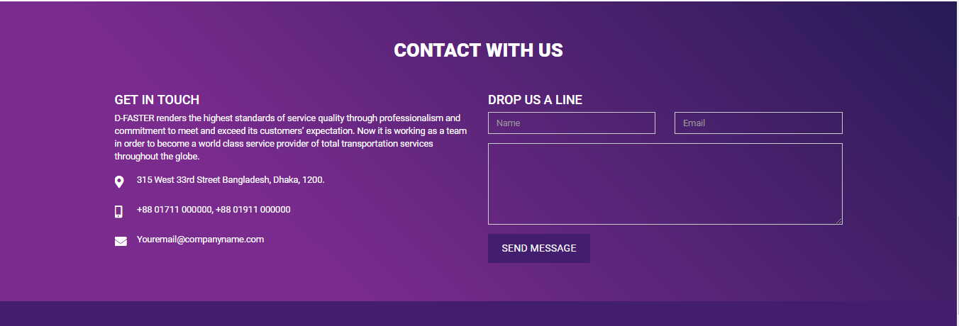
Interface : D-FASTER

Slide 30
Thank You

